Slide 1

Public speaking
A process, an act and an art of making a speech.

Slide 2
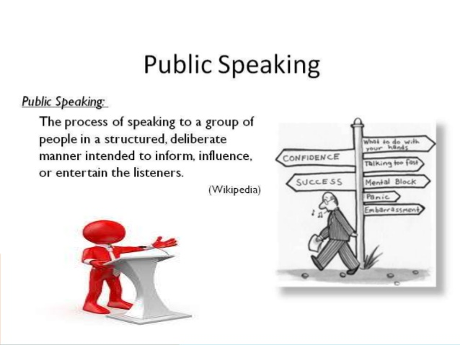
Definition.

Slide 3

Public Speaking
What is Public Speaking?
Public Speaking is a ‘formal’ face-to-face communication method where a person(s) uses the medium of speech to Inform and/or Influence a group of listeners (an audience).
Why is developing Public Speaking skills important?
It is beneficial in many different areas.
Class projects
Job/internship presentations
Club/organization meetings or events
Speech at a family gathering such as a wedding, birthday, anniversary, etc.

Slide 4
Public speaking vs. conversation
Public speaking is the process of speaking to a group of people in a structured, deliberate manner intended to inform, influence, or entertain the listeners.
Conversation is a form of interactive, spontaneous communication between two or more people who are following rules of etiquette.
There are three key differences that set public speaking apart from conversation: organizational structure, use of formalized language, and method of delivery.

Slide 5
Public speaking vs. conversation
Speeches involve thoughts that are logically organized and structured, whereas conversations may wander around subjects. Better conversation is organized too.
Speeches use formalized language, while conversation may use informal and/or poor grammar sometimes.
Speeches are often delivered in deliberate, intentional settings and contexts, whereas conversations may arise spontaneously.
Both demand tailoring of the message to the audience
Personal statement requires a different method for delivery:
More formal delivery
No vocalized pauses – “uh”, “ah”, “um”
Don’t use stock phrases repeatedly – “you know”, “basically”, “I mean”

Slide 6
Public speaking-history.
Public speaking evolved with the development of democracy in Athens.
It gave birth to sophism which lead to logical reasoning and argumentation in order to persuade people the. Finally the art of rhetoric or oratory developed.

Slide 7
Three main types of public speaking
Speeches that inform:
Explain, report, describe, clarify, define and demonstrate. Such speeches can move an audience to action or belief. Their primary purpose is to present facts, details, and examples
2. Speeches that persuade
Are designed to convince and the goal is to influence the audience’s beliefs or attitudes.
This can be accomplished by using your own credibility, appealing to your audience’s emotions, reason, or sense of right and wrong
3. Speeches that entertain
use humor to influence. Once the audience is warmed up, one main idea is presented, still on a light note. Finally bring up the punch line.
Note: This is the most difficult of all presentations because it requires great ease and elegance and depends to a large degree on the charisma of the speaker.
to isolate and understand the primary purpose of your talk

Slide 8

Four basic methods of delivery
1. Reading a manuscript verbatim- A written speech is read out.
2. From memory- If you do have the ability to commit your entire speech to memory, you may do so. If you choose to speak without notes make certain you have the necessary delivery skills.
3. Speaking impromptu- With little or no preparation and without the use of notes. Know what you’re talking about! Include experience. It automatically sounds natural and spontaneous.
Impromptu speaking follows three basic rules:
(a) Have something important to say; (b) Make your audience understand or believe it, and (c) Speak simply, directly and meaningfully.
Notes:
DELIVERING THE GOODS
There are four basic methods of delivering a speech: (1) reading a manuscript verbatim; (2) reciting a presentation from memory; (3) speaking impromptu; and (4) speaking extemporaneously.
1. Reading a manuscript verbatim. A manuscript that is read has several disadvantages. Unless the person who delivers the speech is extremely skilled the recitation will sound just as if it were read and it will likely have a sing-song tone to it. Reading a manuscript also fails to give the audience the eye contact necessary in order to keep attention. If you want to lose your audience entirely pursue this mode!
2. Reciting from memory. Daniel Webster, the famous author of Webster’s Dictionary could thrill audiences for three, four, or even five hours at a time. Even more incredible, he often spoke without using any notes which he attributed to his memory! Few people have Webster’s remarkable powers of memory. If you do have the ability to commit your entire speech to memory, you may do so. But one of the main disadvantages to memorizing an entire speech is that it creates too much pressure to get the speech “absolutely perfect.” Memorizing a speech can also result in a stilted, wooden sounding delivery.
Professional speakers who repeatedly deliver the same speech often commit it to memory, yet with each delivery they adjust the speech to suit the occasion and audience. Only a very skillful speaker can do this. The main disadvantage to memorization is what might happen if your attention was diverted and you could not recall what you were to say next. If you choose to speak without notes make certain you have the necessary delivery skills. You never get a second chance to give a speech.
Speaking impromptu. The impromptu speech is speaking at a gathering with little or no preparation and
without the use of notes. For many it might be likened to trial by fire, but it need not be that bad. Impromptu speaking follows three basic rules: (a) Have something important to say; (b) Make your audience understand or believe it, and (c) Speak simply, directly and meaningfully. Believe it or not, you already know how to speak off -the-cuff. You’ve been doing it for years since you go about your daily business without writing out what you are going to say. And you do just fine at it.

Slide 9
Four basic methods of delivery
4. Speaking extemporaneously-
Includes brief notes and is carefully prepared and practiced in advance. However, the exact wording is chosen at the time of delivery.
Advantages:
It gives the speaker more control over thought and language.
Offers greater spontaneity and directness.
It is adaptable to a wide range of situations.
It sounds spontaneous.
you are free to establish your ideas, can establish strong eye contact, gesture naturally, and concentrate on talking with your audience rather than speaking at them.
Notes:
DELIVERING THE GOODS
There are four basic methods of delivering a speech: (1) reading a manuscript verbatim; (2) reciting a presentation from memory; (3) speaking impromptu; and (4) speaking extemporaneously.
1. Reading a manuscript verbatim. A manuscript that is read has several disadvantages. Unless the person who delivers the speech is extremely skilled the recitation will sound just as if it were read and it will likely have a sing-song tone to it. Reading a manuscript also fails to give the audience the eye contact necessary in order to keep attention. If you want to lose your audience entirely pursue this mode!
2. Reciting from memory. Daniel Webster, the famous author of Webster’s Dictionary could thrill audiences for three, four, or even five hours at a time. Even more incredible, he often spoke without using any notes which he attributed to his memory! Few people have Webster’s remarkable powers of memory. If you do have the ability to commit your entire speech to memory, you may do so. But one of the main disadvantages to memorizing an entire speech is that it creates too much pressure to get the speech “absolutely perfect.” Memorizing a speech can also result in a stilted, wooden sounding delivery.
Professional speakers who repeatedly deliver the same speech often commit it to memory, yet with each delivery they adjust the speech to suit the occasion and audience. Only a very skillful speaker can do this. The main disadvantage to memorization is what might happen if your attention was diverted and you could not recall what you were to say next. If you choose to speak without notes make certain you have the necessary delivery skills. You never get a second chance to give a speech.
Speaking impromptu. The impromptu speech is speaking at a gathering with little or no preparation and
without the use of notes. For many it might be likened to trial by fire, but it need not be that bad. Impromptu speaking follows three basic rules: (a) Have something important to say; (b) Make your audience understand or believe it, and (c) Speak simply, directly and meaningfully. Believe it or not, you already know how to speak off -the-cuff. You’ve been doing it for years since you go about your daily business without writing out what you are going to say. And you do just fine at it.

Slide 10
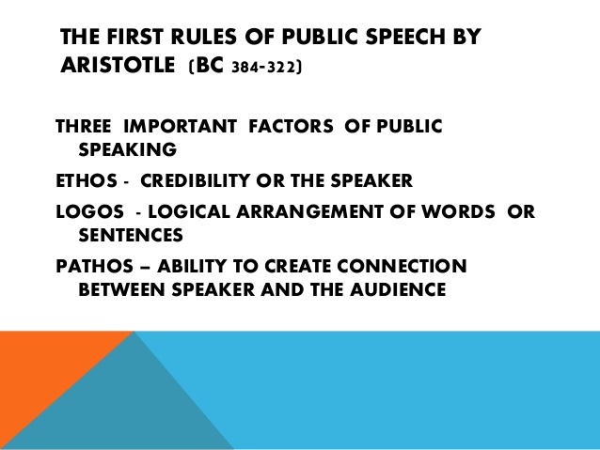

Slide 11
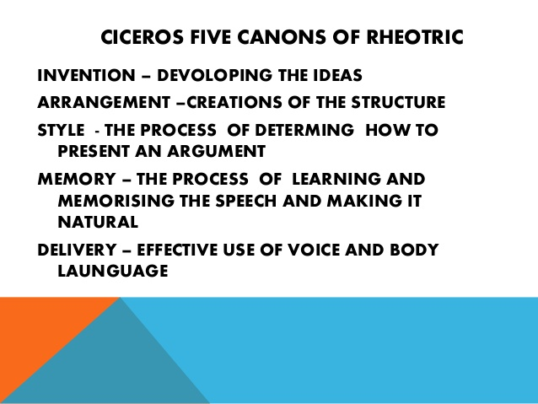

Slide 12
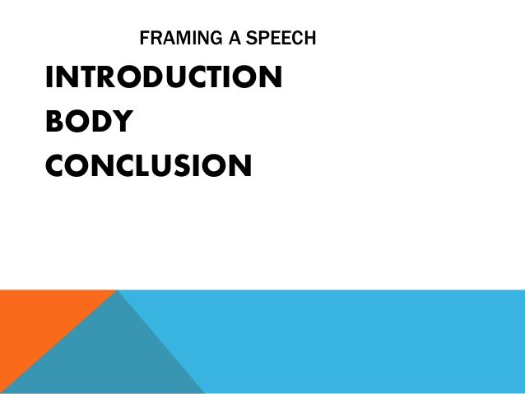

Slide 13

Purpose of an Introduction
Build enthusiasm for speaker
Build enthusiasm for topic
Establish a welcoming atmosphere
Boost credibility of speaker
Notes:
DON’T SWEAT THE SMALL STUFF―HANDLING INTRODUCTIONS, ANNOUNCEMENTS AND PRESENTATIONS
Introductions
If you were introducing the president of the United States of America, it would take no more than nine words: “Ladies and gentlemen, the president of the United States.” The President is so well known that further remarks would be inappropriate. Most of the time, however, the person we have to introduce will not be so well known.
During the introduction you will want to accomplish three things: (1) build enthusiasm for the speaker; (2) build enthusiasm for the topic; and (3) establish a welcoming atmosphere that will boost the speaker’s credibility. A good introduction can do much to ease the task of the speaker. In a good introduction you are basically saying, “Here is a speaker you will enjoy, and this is why.” Usually you will say something about the speaker’s qualifications followed by something about the topic―in that order. Remember, the focus of what is said is to be on the speaker, not on the person making the introduction!

Slide 14
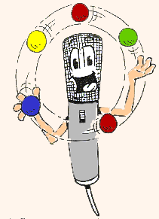
Three things you do during the intro.
Get Attention and create Interest
Reveal the Topic
Startle the audience with an arresting statement/argument
Establish Credibility and Goodwill
Preview the body of the speech
Notes:
There are three things to do at the very beginning:
(1) Get the attention of the audience. You can get attention and interest by relating the topic to the audience. People pay attention to things that affect them directly.
(2) Startle the audience with an arresting or intriguing statement. “Almost one year ago today, a perfect stranger saved my best friend’s life.”
(3) Arouse Curiosity. Give an arresting synopsis of what you will explore. Or you may question your audience. This draws the audience in immediately.
As important as the introduction is, keep it brief. While developing the body of your talk, be on the lookout for possible introductory materials. And be creative in devising your introduction, but don’t worry about the exact wording until you have finished preparing the body of your talk. After you have determined your main points, it will be much easier to make final decisions about how to begin your talk. Then practice the introduction over and over until you can deliver it smoothly from a minimum of notes and with strong eye contact.

Slide 15
Body.
Elaborate the subject
Give a division of the subject
Emphasize on the changes between the divisions
put relevant examples to support your stand
Each main point should be independent of the other main points.
Use the same pattern of wording for each main point
Balance the amount of time spent on each main point.

Slide 16
Organizing a Speech – Supporting Materials
Supporting Materials
The “flesh” that fills out the skeleton of your speech.
Listeners need supporting materials to accept what the speaker says.
Three major types of supporting materials:
Examples
Statistics
Testimony
Always provide sources to give credibility to the supporting materials

Slide 17

The Conclusion
Two Purposes
Let the audience know you are ending
Reinforce central idea
Notes:
The Conclusion
The conclusion ties up the speech and alerts listeners that the speech is going to end. “Great is the art of beginning,” said Longfellow, “but greater the art is of ending.” Many a public speaker has marred an otherwise good talk through a long-winded, silly, or poorly designed conclusion. Your closing remarks are your last chance to drive home your ideas. And your final impression will probably linger longest in your listeners’ minds. The conclusion has two major functions: (1) to let the audience know you are ending your talk and (2) to reinforce the audience’s understanding of the central idea.
You can let your audience know your talk is ending by saying, “In conclusion,” “One last thought,” “In closing,” “Let me end by saying”–these are all brief cues that you are getting ready to stop. You can also let your audience know the end is in sight by devising a conclusion that hits the hearts and minds of your audience. A dramatic story that brings tears to the eyes of the listeners. The conclusion should take up no more than 5 to 10 percent of the time allotted. Nothing aggravates an audience more than a speaker who says, “And in conclusion,” but then drones on and on.
Give your speech a title is one if needed. In most cases, the title should be brief, attract the attention of those who might attend, and encapsulate the main thrust of your talk. Allow at least four hours of preparation time for every half to one hour of presentation. An inexperienced person may spend even more time than this. So begin this task early.
THE SPEAKING OUTLINE
Most people today thoroughly prepare and practice in advance, but speak extemporaneously, selecting much of the wording while delivering the talk. Your talks will probably be of this type.
The speaking outline will help you remember what you want to say. It is really a condensed version of your preparation outline. It contains key words and phrases to jog your memory with trigger words you do not want to risk forgetting. You should use a similar indentation as in your preparation outline. This will allow you to see at any given moment where you are in your talk while you are speaking. As you are talking you will look down at your outline periodically to make sure you are covering the right ideas in the right order.

Slide 18
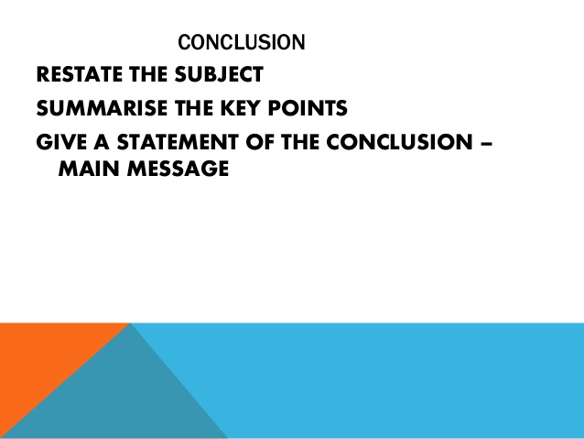

Slide 19
Elements of a Good Speech:
Attitude/posture
Rehearsal
Vocal expression/voice tone and mood.
Nonverbal expression

Slide 20
Elements of a Good Speech:
Attitude:
Attitude can be defines as the position or posture of the body appropriate to or expressive of an action, emotion, etc.
Attitude matters a great deal with delivery.
A confident presence is an aspect of your credibility and persuasiveness.
Yet people have speaker apprehension- fear of speaking in front of an audience.
This fear can become a self-fulfilling prophecy: we can make ourselves fail . . . or succeed.

Slide 21
Elements of a Good Speech: Don`ts.
Don’t:
Don’t comment on your own performance.
Don’t apologize for your speaking, especially not before you speak.
Don’t hide behind the stand, wear hats, or chew gum.
Don’t look over the audience heads.
Don’t “watch your own feet when you dance.”
Don’t give up on yourself.
Don’t go away and try to get it “perfect” on your own before you let anyone see it. Get help when you need it..
You’re just the messenger. Don’t stay focused on yourself or how people are regarding you. It’s not just about you.
Of the three elements necessary to the speaking process: a message, an audience for which the message is designed, and a messenger, the messenger is less important.

Slide 22
Elements of a Good Speech: Dos.
Be conversational. A public speaking situation is still personal if you speak naturally and make eye contact. Look at people, they’ll relate to you.
Move like you do in normal life, but much less.
Stay focused on your material. You’re just the messenger, not the point of the message. If you’ve chosen topics well, it’s vital that you get this information to your fellow citizens.

Slide 23
VOCAL EXPRESSION-/voice and tone.
You must speak loudly enough to be heard, clearly enough to be understood, and slowly enough for your audience to keep up.
There are five dimensions of voice that can be manipulated for greater effect.
Volume - Speak louder or softer for emphasis.
Pitch - Stay at an appropriate mid-range level.
Rate - Accelerate for a few sentences to excite, slow down and pause to emphasize some words.
Articulation - Speak clearly with full voice.
Quality - The personality of your voice, resonant, throaty, nasal, etc.

Slide 24
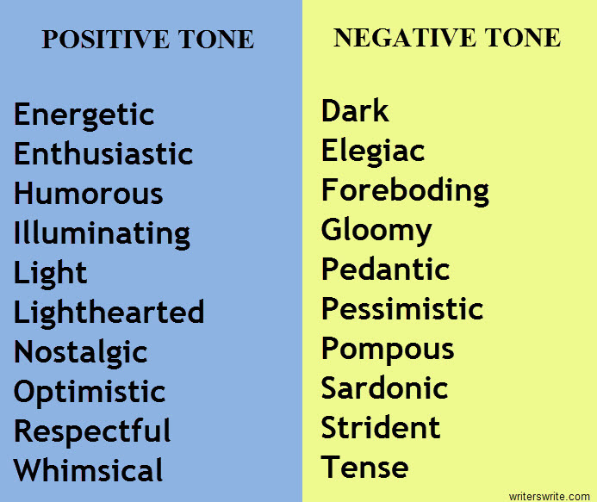
Be appropriate in tone.
TONE is simply the author’s attitude toward the subject. Tone must be inferred through the use of descriptive words.

Slide 25
More words of tone.
Bitter
Serious
Witty
Playful
Tender
Sympathetic
Haunting
Mysterious
Suspenseful
Tasteful/distasteful
Nonchalant/relaxed
Angry
Attached/Detached
Innocent
Poignant
Compassionate
Humorous

Slide 26
MOOD: the overall feelings or emotions that are created IN THE AUDIENCE.
Cheerful
Relieved
Gloomy
Bleak
Uncertain
Bittersweet
Relaxed
Lazy
Hopeless
Tense
Furious
Disappointed
Dreamy, foggy
Content
Satisfied
Angry
Motivated
Inspired
Confident
Eerie/strange

Slide 27

Body language- Impact percentage
HEY,
WHAT
ARE YOU
GUYS DOING
OVER THERE?!
NONE OF
YOUR
BUSINESS!
Verbals 7%
Tone of Voice 38%
Non Verbals 55%
WOULD YOU
GUYS KEEP IT QUIET UP THERE?!
Notes:
LET ME HEAR YOUR BODY TALK―BODY LANGUAGE
Body communication includes eye contact, gestures, expressions, and posture. It is so important because 55% of what you communicate is delivered this way―without words! Novice speakers are often unsure about what to do with their bodies when giving a talk. Some pace back and forth across the platform. Others shift their weight back and forth from one foot to the other, fidget with their notes, or jingle coins in their pockets. Such quirks usually stem from nervousness. With concentration, such mannerisms should disappear as you become more comfortable speaking in front of an audience.
Body Posture. Whenever possible, stand at a slight angle to the audience. When you want to emphasize key points, simple “square” your shoulder to face the audience. To create drama and make a more powerful impression, you can even move a step or two closer to your listeners.
We have probably all seen speakers who roam all over a platform when speaking, sometimes pacing back and forth. Feel free to move about when speaking. But too much pacing can be distracting to your message
Hand Gestures. Gestures can be used to enhance a speech or distract an audience, depending how they are used. Here are some practical pointers on how you should and should not use your hands:
* Your hands naturally belong by your side when you are not gesturing. Do not put your hands behind your back, in your pockets, or hold them in front of you. This makes an audience focus on your hands, not your message.
* Your hands belong at your sides even when using a podium unless you are gesturing. Do not place your hands on the podium or table as it makes it look like you have to hold yourself up.
* Most hand gestures should be about chest level. Lower gestures draw audience attention away from your face.
* The open hand is a highly effective hand gesture. Showing the open palm of your hand conveys openness and encourages trust Avoid making a fist as well as pointing at the audience. No one likes to be pointed at. (This may vary in some cultures – be sure you know local customs.)
What you need to remember about gestures is that they should not draw attention to themselves or distract from your message. They should appear natural and spontaneous as well as match the mood you are trying to create. Gesturing naturally comes with experience and confidence. At first, work on not flailing your hands them wildly about or wringing them, cracking your knuckles, or toying with your rings. Forget about your hands. Think more about communicating with your listeners and your gestures will take care of themselves.

Slide 28
Nonverbal Expression
The nonverbal frames the verbal in this sense: whichever behavior interrupts the other is the one that takes audience focus. If I move to draw their attention - gesture or take a step - then speak, they’ll hear me. If I start to speak, then move aimlessly, they’ll watch but not hear.
Stand still for a moment and make eye contact with your audience, then start. Speak only once you’ve made contact. Stay in one place for awhile. Don’t pace around through the speech. Choose 2 or 3 places where you’ll take a step or two. Literally, “move into” your next argument.

Slide 29
Nonverbal Expression
▪Gesture naturally, as you would when you talk with friends.
Free your hands as much as possible to “allow” that to occur.
Make the manuscript your friend with large font, double spacing, and only complete sentences on one page.
Use the stand for your notes.
Keep your hands out of your pockets.
▪Clothing and accessories are an aspect of your persuasion.
“The outside appearance is frequently an index to the mind, and we should be careful what signs we hang out for the world to judge of our faith.”
1)Dress appropriately to the occasion.
2)Don’t hide under hats or behind sunglasses.
3)Watch dangling jewelry.

Slide 30
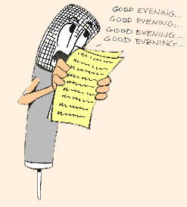
Rehearsal: Practice! Practice! Practice!
Prepare speaking outline
Practice aloud
Polish & refine delivery
Present under similar conditions
Notes:
PRACTICE DELIVERY
You should practice all aspects of your delivery along with the words you plan to use. Start your practice sessions early so you will have plenty of time to gain confidence in your presentation. The following five steps may help:
1. Prepare your speaking outline. Make sure your speaking outline is easy to read at a glance. Keep it brief.
2. Practice your presentation aloud several times using only the speaking outline. Talk through all your stories and examples. If you plan on using visual aids, use them as you practice. Instead of trying to learn your talk word for word, concentrate on gaining control of the ideas. After a few tries you should be able to get through your talk with surprising ease.
3. Polish and refine your delivery. Practice your presentation in front of a mirror and check for eye contact and distracting mannerisms. Tape-record your message to gauge volume, pitch, rate, pauses―and vocal variety. Best of all, try your presentation out on your family or friends―or anyone who will listen. You need to know it goes over well with people.
4. Give your talk under conditions similar to those in the real thing. If you are presenting in a church, go to a church (during non―worship hours), and give the presentation aloud there. Regardless of where you hold your last practice session, you should leave it feeling confident and looking forward to the real event.
When in the early stages of planning public presentations, concentrate on such basics as speaking intelligibly, avoiding distracting mannerisms, and establishing eye contact with your listeners. Once you get these elements under control you can work on polishing your delivery in order to make a greater impact. Eventually you may be able to control the timing, rhythm, and momentum of a speech as skillfully as a conductor controls an orchestra.

Slide 31

Rehearsal :Points to Remember
Check facts for accuracy
Adapt remarks to occasion
Adapt remarks to audience
Create a sense of anticipation
Notes:
First, make certain the facts presented about the speaker are accurate. Unless you have been given an introduction about the speaker to be read aloud, always check with the speaker ahead of time to make sure what you are about to say is accurate. Above all, make certain you have the speaker’s name correct. A name is a person’s identity and if you get that wrong, you strip her of her identity and importance.
Secondly, adapt your remarks to the occasion. Formal occasions, such as in a worship service, require a more formal introduction. If introducing a person at an informal monthly meeting, you can be much more casual than if introducing the same person during a worship service.
Thirdly, adapt your remarks to the audience. Just as you adapt a presentation to a particular audience, you adapt an introduction to the audience you are facing. Your goal is to make this audience want to hear this speaker on this subject. If the speaker is not well known to this audience, it is up to you to establish his or her credibility by recounting some of the speaker’s main achievements. If you were introducing a person to a group of children, the introduction would be totally different than if introducing the same speaker to a group of adults for a worship service.
And finally, try to create a sense of anticipation and drama. This can be done by mentioning the speaker’s name last. There may be occasions to break this convention, but even when the audience knows the person, you can build a sense of drama building up to mentioning the name last. If you are called upon to introduce someone well known to the group try to be creative and cast the person in a new light. Talk to the speaker ahead of time and see if you can learn some interesting facts that are not generally known.
Even though the speech of introduction is short (no longer than 1 l/2 to 2 minutes maximum!) it should be written out in advance, at least in outline form and practiced. This is a must if you expect to be creative and dramatic. In the end you should be able to deliver the introduction extemporaneously, with sincerity and enthusiasm.
Your final sentence might sound something like this: “Please join me in giving a warm welcome to Ardis Stenbakken.” Once you complete this last sentence, you would begin the applause and remain at the podium until she arrives. Once she is at the podium, shake hands with her and move quickly to your seat.
Making Announcements
Announcements should be made in much the same manner as the speech of introduction. They too should be brief, accurate, adapted to the situation as well as creative and sometimes dramatic. Hopefully you would be asked in advance to make the announcement so there is time to prepare, check the facts, get some creative ideas together and sketch out your ideas on paper. Should you be asked to make an announcement in the last minute, take a few minutes even then to check the facts and sketch out in very brief form what needs to be said to announce the event.
Presenting an Award
Should you be called upon to present an award, you would again follow the same guidelines as in the speech of introduction. The idea is to build credibility and positive feelings before the award is presented. As in the speech of introduction, it is better to build anticipation to hearing the person’s name at the end of the speech. Again you would invite the audience to applaud the award winner by leading the applause yourself.

Slide 32
MUST DO’S IN A PUBLIC SPEAKING
1. Smile and have fun
2. Speak loud
3. Relax
4. Be yourself
5. Know your Audience
6. Be confident
7. Claim Attention
8. Wrap up your speech on time
9. Be flexible
10.Connect with your people during the presentation
11.Face your Audience
12.Use more gestures
13.Use simple and understandable language

Slide 33
DON'TS IN A PUBLIC SPEAKING
1.Do not get fearful.
2. Do not rush through your presentation 3. Do not stick your hands in your pockets 4. Do not underestimate your Audience
5. Do not point fingers
6. Do not hurt people feelings
7. Do not dictate
8. Avoid unbecoming language
9. Avoid repetition of the works or phrase
10.Do not put-up an aggressive face
11.Don’t make things which you are not sure about

Slide 34
FACTORS INFLUENCING A PUBLIC SPEAKING
The positive outcome of a speech does not depend solely on the oratory skills of the speaker. It is influenced by many factors such as:
▪ The topic of the presentation
▪ The attitude of the audience
▪ The quality of material
▪Thorough knowledge about the Matter
▪ The length of the speech
▪ Body language
▪ Supporting pictograms, diagrams etc.
▪ Pitch variation and so on…..

Slide 35
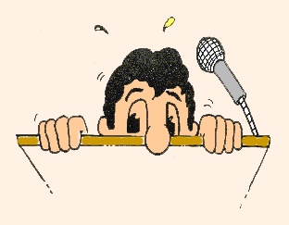
You can reduce stage fright by
Preparation & rehearsing 75%
Deep breathing 12%
Mind Control 10%
Notes:
Overcoming Stage Fright
Butterflies. The jitters. A bad case of nerves. Fear of speaking in public is called “stage fright” but it begins long before one gets to the stage. For many it begins the minute they get the invitation to speak. Some fear their audience, and the more you fear your audience, the more nervous you become. Actually audiences are usually sympathetic to stage fright. Even if they notice you are frightened they usually attempt to encourage a speaker. Here are some tips to help you overcome fear:

Slide 36
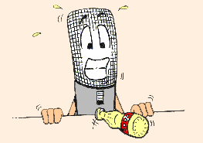
Tips for overcoming fear
Pick your own subject matter
Follow the “as if” principle
Put on a happy face
Think positively
Picture your audience as friendly
No apologies
Pray again, again, and again
Notes:
* Pick your own subject matter. The more you like your subject, the more apt you are to see your audience as friendly.
* Follow the “as if” principle. Act as if you are confident, and you truly will become more confident. This is a real psychological theory put into a nutshell of truth: Your body tends to do what your mind expects. If your mind expects a successful presentation, your body is more likely to produce one.
* Put on a happy face. If you are smiling, your audience will be much more likely to smile with you. If you look scared and miserable, you will unconsciously set the mood for misery.
* Think positively. Avoid negative thoughts like the plague! Instead, use affirming statements to yourself: “I am well prepared and know my subject. That’s why I have been asked to give it. I can deliver it well.” This type of positive thinking really works!
* See your audience as non-threatening rather than fearing them. Remember, your audience is not against you―at least not yet. They have voluntarily come to hear you speak. Act like you like them, that you are going to have some fun together and they are more likely to like you.
* Fake it. Don’t get up front and say, “I just have to tell you how nervous I am.” You may be frightened, but no one will know it if you don’t tell them!
* Pray. Make it your practice to pray before you present. Pray for yourself as you deliver your speech, but also pray for the people in your audience―that they might receive all the thoughts of love and good will that you have for them.
Some people actually shake or tremble when fearful. But even trembling doesn’t show half as much as you think it does. If you are a trembler, leave the microphone on its stand rather than holding it in your hand. Leave your notes on the lectern so that people can’t see them shake in your hands. If your legs tremble, shift your weight between them. Or lean forward and grasp the lectern with both hands until the trembling stops.
Believe it or not, stage fright has its good points. Fear produces energy and you can draw on that energy and enthusiasm to help you give a more powerful presentation. Since most people see public speaking as very difficult, when you stand up to speak you will automatically get some respect. You hardly have to do anything else. Just standing before a group gains respect. Then if you are fully prepared you can be confident in your ability to carry this off. Tell yourself, “I am completely prepared. I wrote a good talk and I know my material. I will go out there and with God’s help, I will do a good job. “ Remember, the best way to overcome stage fright is to believe in yourself!
Accept every opportunity you can to speak. Each time you get up front will become easier. In time it won’t be so terrifying.
CREDIBILITY
One of your prime objectives when speaking to an audience is to establish credibility and good will. Credibility is mostly a matter of being perceived by your listeners as being qualified to speak on a given topic. If, for example, I attempted to speak to you about nuclear physics, I would have to take drastic steps to demonstrate my credibility on the subject since I have limited knowledge of the subject. You too must establish credibility before your audience. Your credibility can come from your elected position as a leader of women, reading, classes, you’ve taken etc. Whatever the source of your expertise, your audience needs to know.
You can be helped toward credibility by preparing an introduction typed up in advance and sent to the one who has been asked to introduce you. Since I speak professionally for many organizations, this is what I have done. My introduction includes the number of books I have written, how many languages they have been translated into, special honors I have received, personalities I have appeared with, and a few other pertinent facts that would establish my credibility to a group before I begin. This promotes a positive attitude among the audience and leaves me with less “proving” to accomplish.
GENDER BENDERS
A number of researchers believe that gender differences in conversational styles result in mis-communication that often occur in male-female conversation. For example, research shows that women tend to nod their heads more and give more affirmative verbal cues than do men. Men, in contrast, interpret such signals to mean “I agree,”: rather than “I understand.” A female speaker who sees males in her audience failing to nod in agreement with her, may assume that they aren’t listening, don’t agree or that she is being ignored.
Males may also view topics differently than do women. And generally speaking, males have different interest levels, knowledge, and experiences than females about the topic being presented. In order to pick up male interest on a topic be sure to include examples and stories men can relate to.

Slide 37
Eye Contact
Speaker
Section 1
Section 2
Section 3
The speaker has three major sections to make eye contact with
Speaker
Section 1
Section 5
Section 2
Section 3
Section 4
Audience
The larger the audience, the more sections you need to establish for effective eye contact
Notes:
Eye Contact
The quickest way to establish a bond with your listeners is to look them in the eye pleasantly. Avoiding their gaze is one of the surest ways to lose them. Speakers who can’t look into the eyes of their listeners are perceived as insincere or dishonest. You should be looking into the eyes of your listeners 80 to 90 percent of the time you are speaking.
Avoid however, the tendency to look at one part of the audience while ignoring the rest. Try your best to establish eye contact with the entire audience. If you are speaking to 25 to 50 people you can divide your audience in three and make eye contact with different people in each section throughout the presentation without making anyone uncomfortable. If your audience is larger, you should vary the sections in which you make eye contact. When addressing a small group you can usually look briefly from one person to another. For a larger group, you can scan the audience as a whole rather than trying to engage the eyes of each person individually. No matter what the size of your audience, your eyes should convey confidence, sincerity and conviction. They should say, “I am pleased to be able to talk with you. I believe deeply in what I am saying and I want you to believe it too.”
During your presentation, look for the cheerleaders―the achievers who make up about 20 percent of any group–and appeal to them. If you win over this group, the belongers who make up about 50 percent of any group, tend to follow.
Some presenters tend to be pulled toward the negative person in the audience. Rather than being energized by those who are smiling and nodding in agreement, they are pulled to the one with the frown, or the one who has fallen asleep. Don’t waste your time on such a person. You will likely lose your train of thought and miss out on others who are much more interested.
During your presentation keep coming back to the cheerleaders. They will make you feel good and give you confidence to make your best presentation.
Facial Expressions. The initial feeling an audience gets from a speaker comes primarily through facial expressions. The expressions on your face can make an audience feel relaxed or anxious. To use facial expressions effectively, be yourself. Don’t try to act like someone else you’ve seen. And smile before you begin speaking. A smile is the easiest and cheapest way to improve your looks on or off the platform. It’s hard to go wrong if you offer your listeners a good smile. They may not always agree with what you are saying, but they will like you more if you smile when you speak.
WINNING CONVERSATION―HOW TO TALK SWEET
The voice has been called the melody of conversation: it can be loud, soft, harsh and angry, or mellow and soothing. The tone of voice, which represents 38 percent of any message delivered, can draw others toward you or push them away. Next to nonverbal communication, it carries the most weight in any spoken message.
Voice pitch, volume, tone, speed, number and length of pauses, stammering, intensity, and emotion conveyed all give a meaning far beyond the words themselves. A word may be a word, but how it is received is dependent on how it is said. Some messages are so loaded with emotional overtones that they deny the reality of what was said.
Meaning is given to words by the sender as she chooses the words, but also is taken by the listener as she listens and interprets. Not everyone interprets meanings in the same way. Others don’t always use words the way we do, and we can end up with all sorts of misunderstandings.

Slide 38
Room Setting
Speaker
Audience members should be able to easily see the speaker and visual aids the speaker presents.
Audience
Podium
Audience
Audience
Audience
Audience
Notes:
ORCHESTRATING THE ENVIRONMENT―THE CLASS ROOM
Room Setting
Although you cannot always control the speaking setting, it is very important in effectively communicating your message. The room setting includes such factors as room arrangement, lighting, temperature, and even decor. Remember, the ones setting up the event are often not speakers themselves. As the invited speaker, you have the right to request or make recommendations to the person in charge.
If you can control the design of the room, what design is best? First, the door needs to be at the back of the room. This may seem likely an unnecessary statement, but you simply do not want people walking in a door behind or to the side of you. Yet frequently rooms have side doors through which people can enter and exit. This is a major distraction to audience attention. Try to arrange the room so that traffic moves through the rear door only or one that is closest to it.
Ideally, you want a room which appears to be a bit crowded―not a room where people are packed in and there is standing room only. But a room that is well filled makes you feel more successful and creates a room that is more upbeat for the audience. When a room is large and the attendance small and the people are isolated from each other, it becomes a difficult task to motivate them toward anything let alone join in laughter. Take the same group and put them in a smaller room where they are shoulder to shoulder with a neighbor and you’ve created a warmer atmosphere where it is easy for laugher and a positive attitude to take over.

Slide 39
Seating Arrangement
(Screen or Blank Wall – elevated if possible)
Overhead Projector
◙
X
☻ ☻
☻ ☻
☻ ☻ ☻
☻ ☻ ☻
☻ ☻ ☻
☻ ☻ ☻ ☻
☻ ☻ ☻ ☻
☻ ☻ ☻ ☻
☻ ☻ ☻ ☻
☻ ☻ ☻ ☻ ☻
☻ ☻ ☻ ☻ ☻ ☻
Book Table
(May need 2)
Refreshment Table
Registration Table
Back of Room
Notes:
Seating Arrangements
One of the most important aspects of the speaking setting is the seating arrangement. Unless you are speaking in an auditorium where there is fixed seating, you should be able to suggest how you want the audience seated. As a general rule you’ll want the audience in what is known as “theater style” two to three horizontal blocks with one or two aisles. The aisles allow you to move closer to your audience, and allows participants to get to you when necessary. This keeps the audience close to you, and allows for everyone to see you as well as any visual aids presented. You will also be able to easily make eye contact with everyone in the audience. This pattern will also assist you in keeping audience attention.
Arrive early so you can adjust the seating to your own needs. Add extra chairs. Create an aisle. Move the front row closer or further from you. All of this must be done before the audience arrives. Once listeners are seated, they will not be happy if you ask them to move. Asking an audience to move is like asking a pig to sing: You only waste your breath, and annoy the pig. In the end, the pig still won’t sing and the audience still won’t move.
If you are speaking to a small group (30 to 50) where there are movable chairs, you might arrange the chairs in a semi circle around you several rows deep if necessary. This provides good viewing for each participant since no one sits directly behind anyone’s head. This seating fosters an atmosphere where learning can be fostered in an informal manner, where best viewing of the speaker and overheads can be achieved–all with a feeling of warmth. Where there is fixed seating rope off back rows in an effort to get people to move forward. Fixed seating with straight rows symbolizes formality and rigidity.
There are many more seating options than you might think:

Slide 40
Task
On a random topic given by audience or the teacher, try to speak for 1 minute.

